Slide 2
form an OpenAPI specification implement a dumb service with fake/random data
Requirements
accept configurations for OAuth authentication (at generation time) to secure the API endpoint and provide an out of the box functionality

Slide 3
Risorse API
Potenzialmente vulnerabili ad una ampia gamma di rischi alla sicurezza
Utenti non autorizzati possono guadagnare l’accesso a dati sensibili.
Necessità di proteggere le API:
Attacchi di tipo injection e DDoS per sovraccaricare le API con grandi quantità di traffico.
Protocollo di autorizzazione

Slide 4

OAUTH
Protocollo standard per quanto riguarda l’autorizzazione
Permette ad un client di terze parti di ottenere accesso limitato a delle risorse messe a disposizione dal resource owner
Emissione di un token di accesso da parte di un server autorizzativo ad un client di terze parti

Slide 5
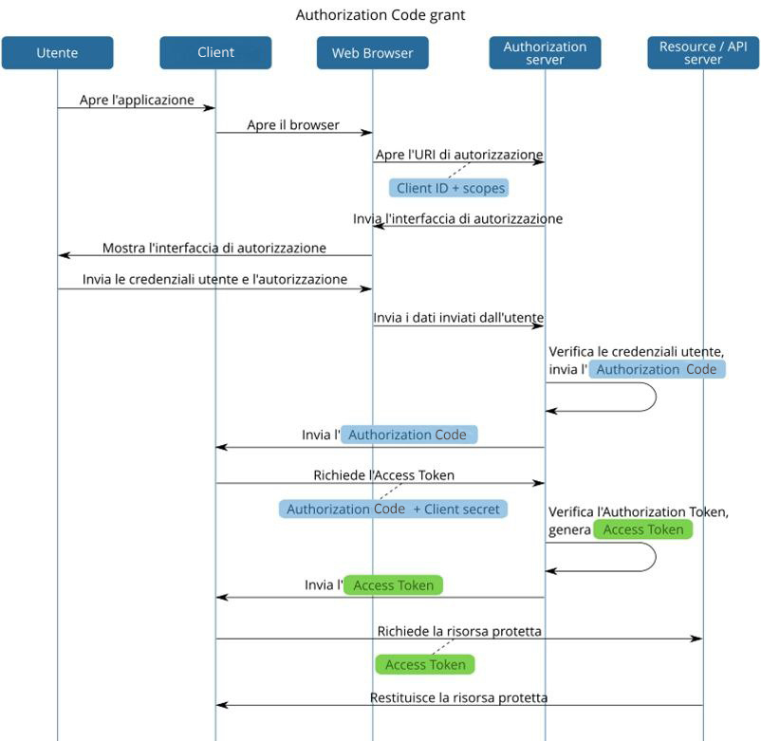
Authorization Code Flow
Client
Richiede l’autorizzazione per poter accedere a determinate risorse messe a disposizione dall’API Server
Authorization Server
API Server

Slide 6
Authorization Code Flow
Client
Authorization Server
In cambio di un Authorization Code fornisce un Access Token al client che gli consentirà l’accesso a determinate risorse
API Server

Slide 7
Authorization Code Flow
Client
Authorization Server
API Server
Fornisce le risorse API utlizzate dal client, corrisponde all’entità più critica del sistema.

Slide 8
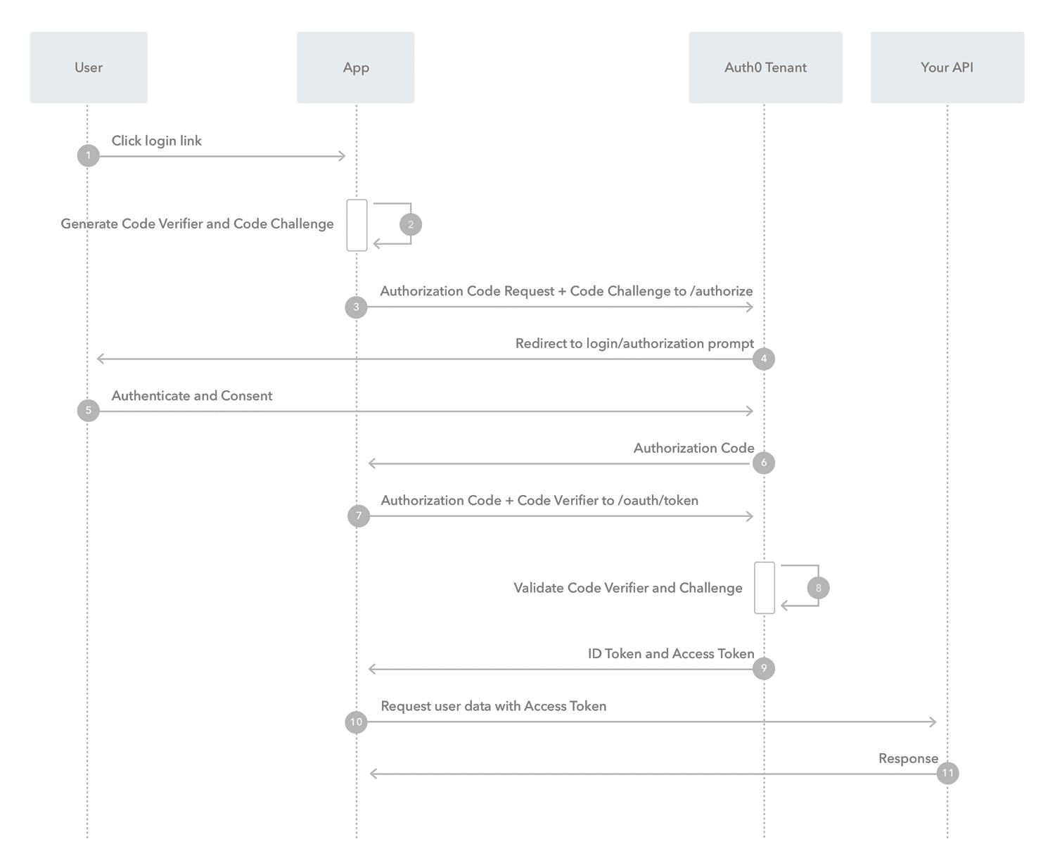
PKCE Proof Key for Code Exchange
2. Generazione
Il client genera un code verifier in modo casuale e ne deriva un code challenge
3. Invio code challenge
7. Invio code verifier

Slide 9
PKCE Proof Key for Code Exchange
2. Generazione
3. Invio code challenge
Durante la richiesta dell’authorization code viene inviato il code challenge che viene salvato dall’auth server
7. Invio code verifier

Slide 10
PKCE Proof Key for Code Exchange
2. Generazione
3. Invio code challenge
7. Invio code verifier
Durante la richiesta per l’access token viene inviato il code verifier, utilizzato per ricalcolare e confrontare il code challenge iniziale

Slide 11
Time
Document verification can require days or even weeks to be handled. Human operators can increase the probability of errors.
Physical archives
Falsification

Slide 12
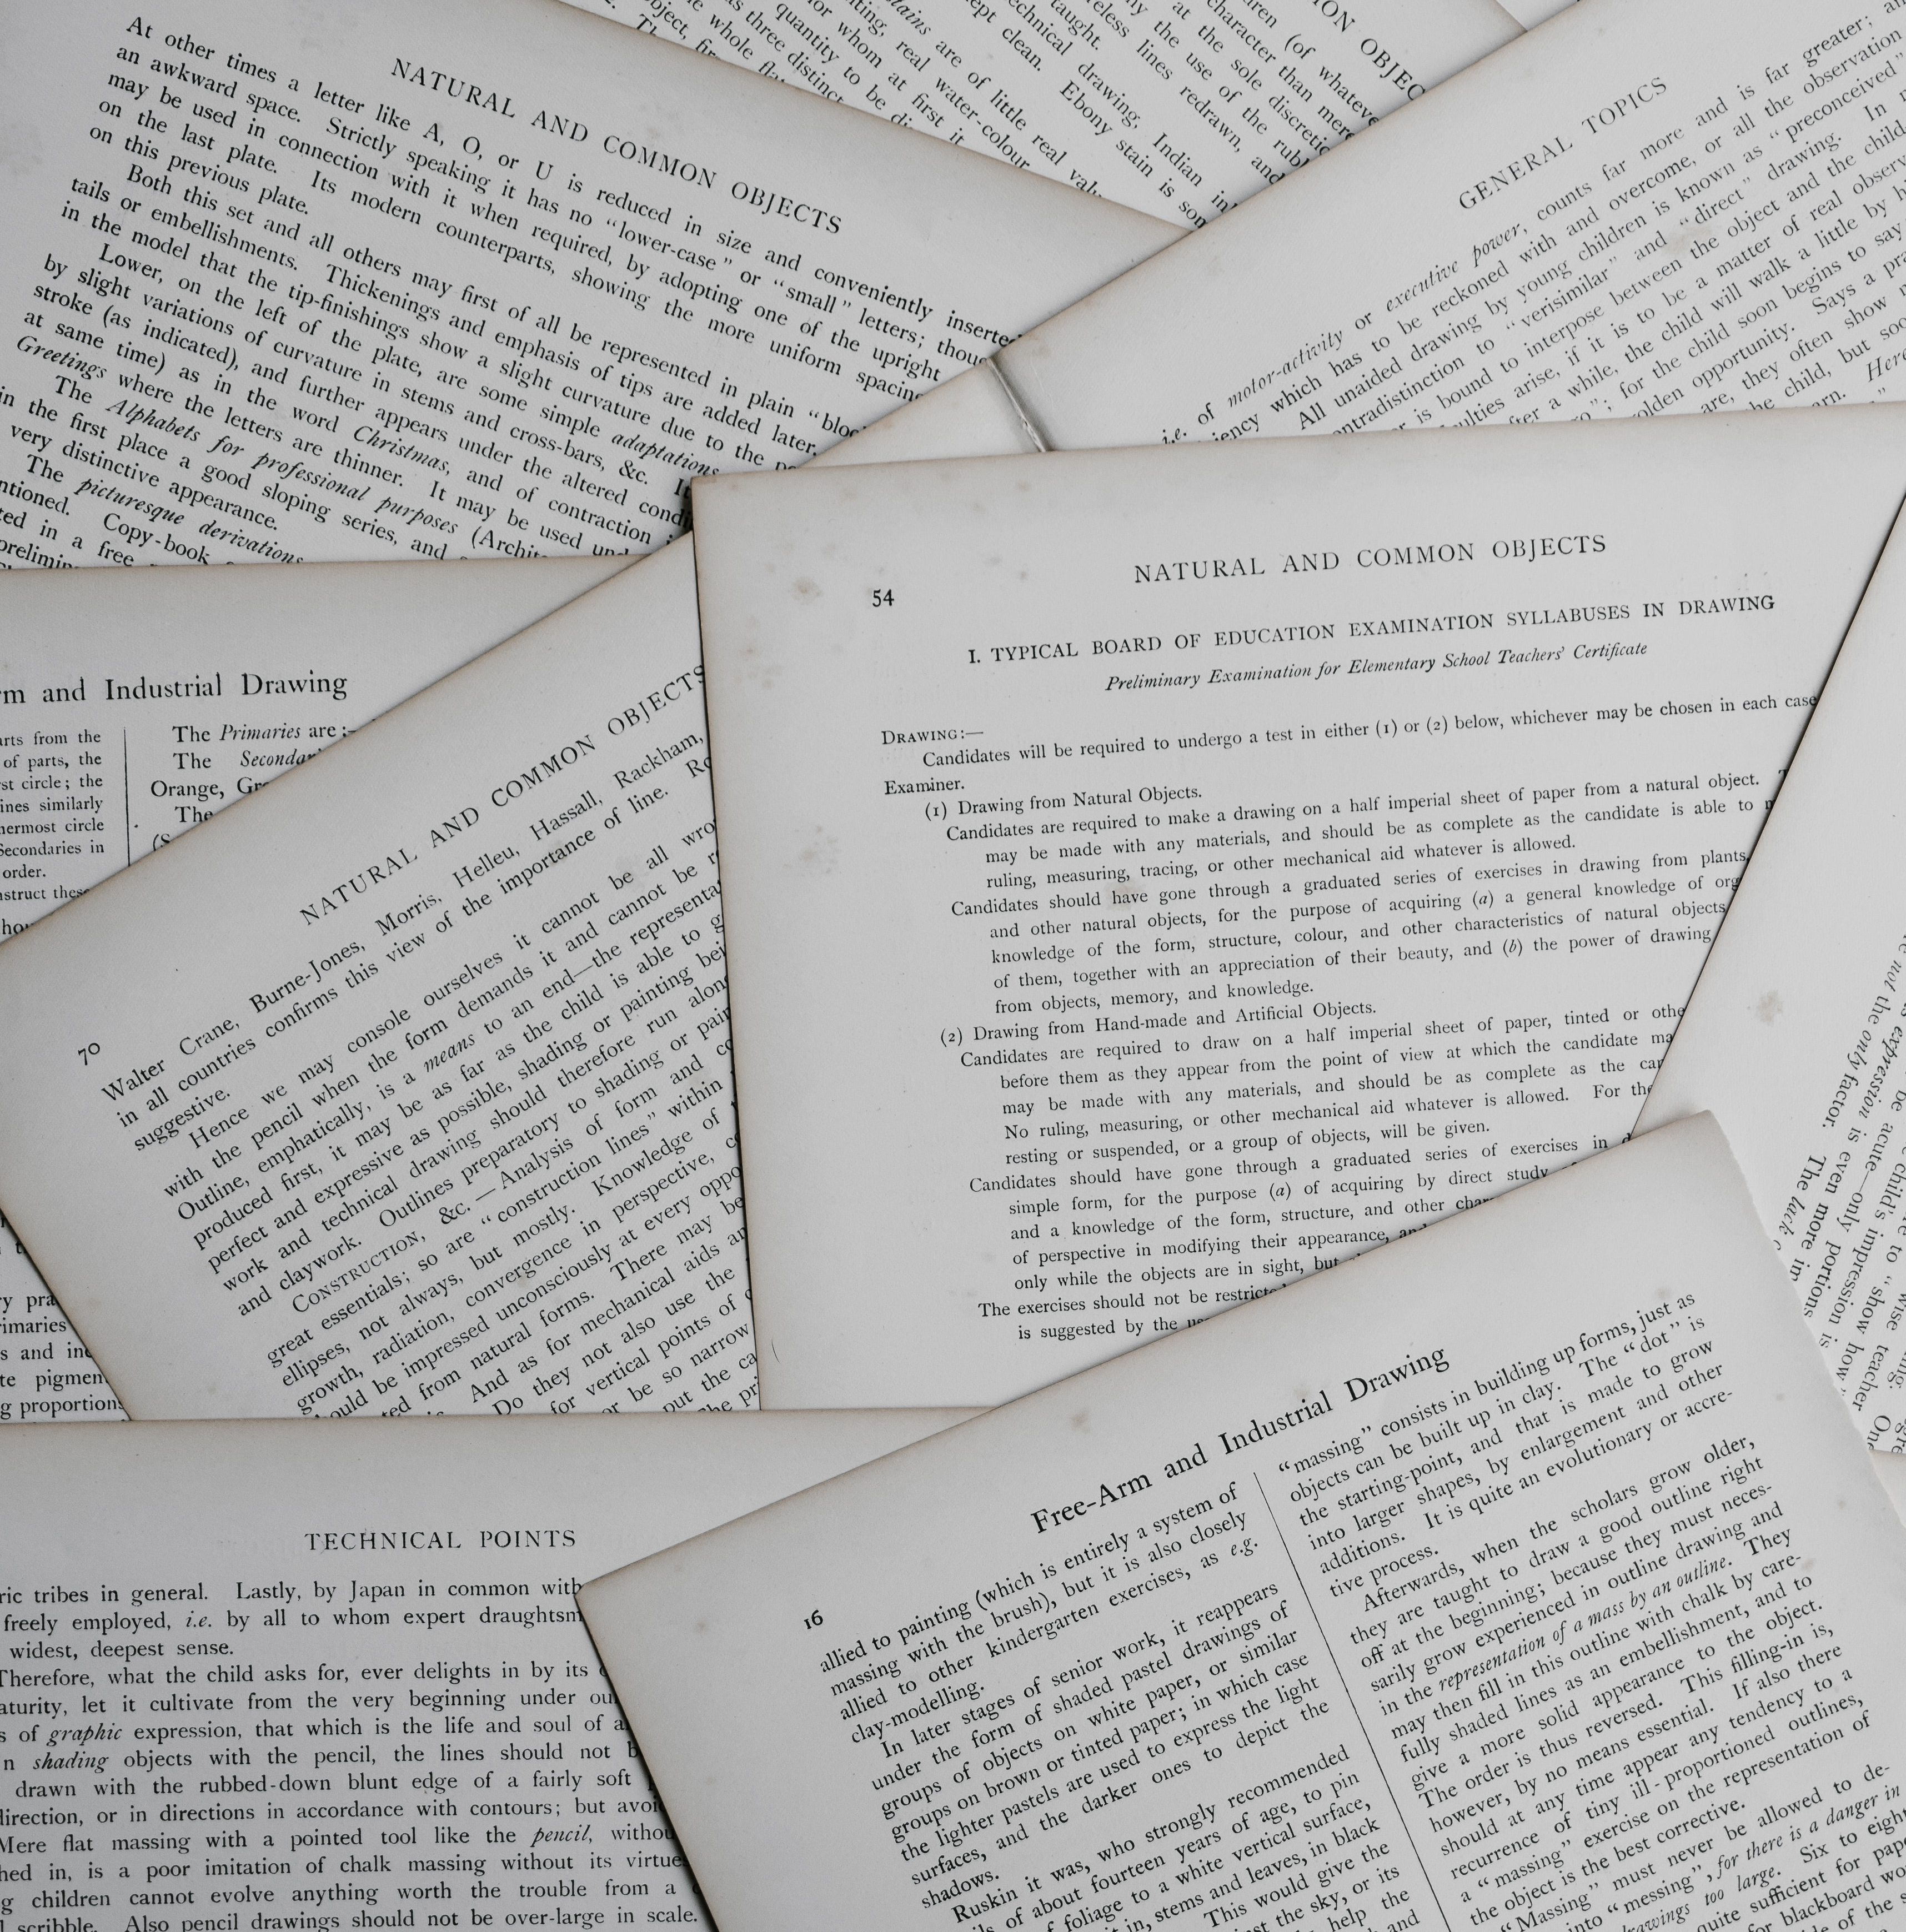
Time
Physical archives
Too much paper for something that can be digitalized. Searching through thousand papers is not pleasant at all.
Falsification

Slide 13
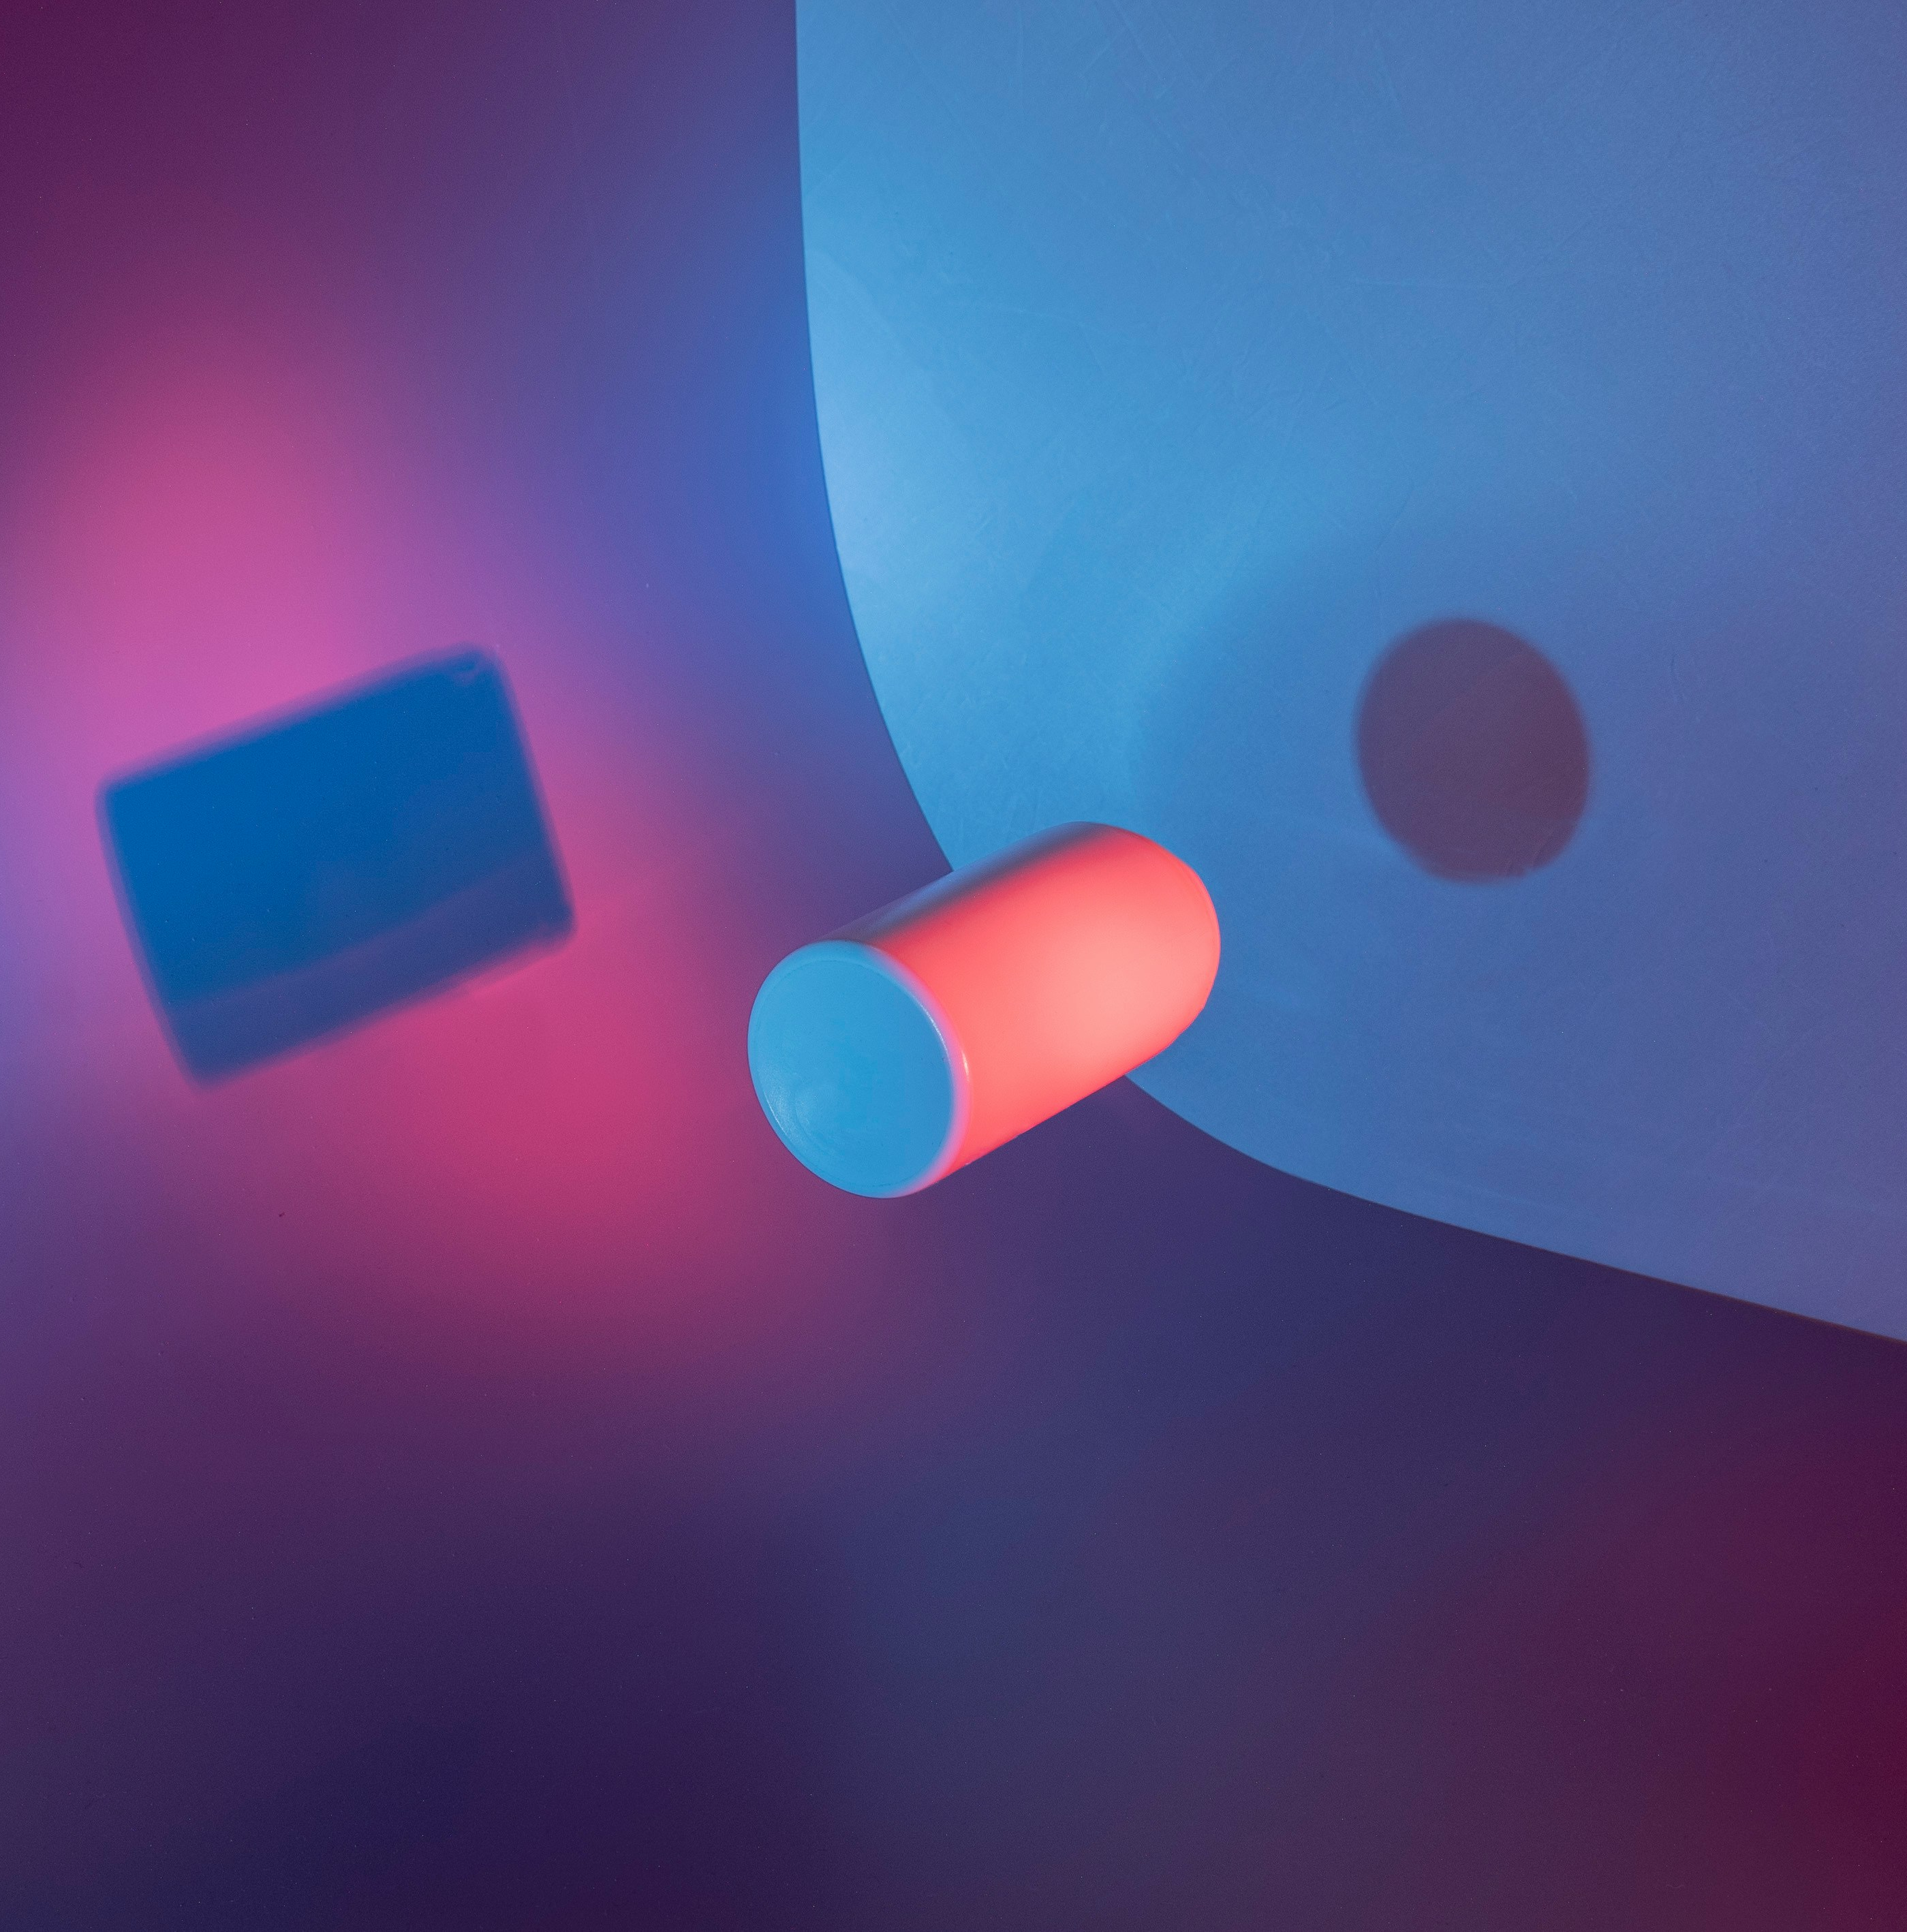
Time
Physical archives
Falsification
Physical documents can be easily forged and difficult to verify. Digital ones needs to be signed with difficult to use algorithms.

Slide 14

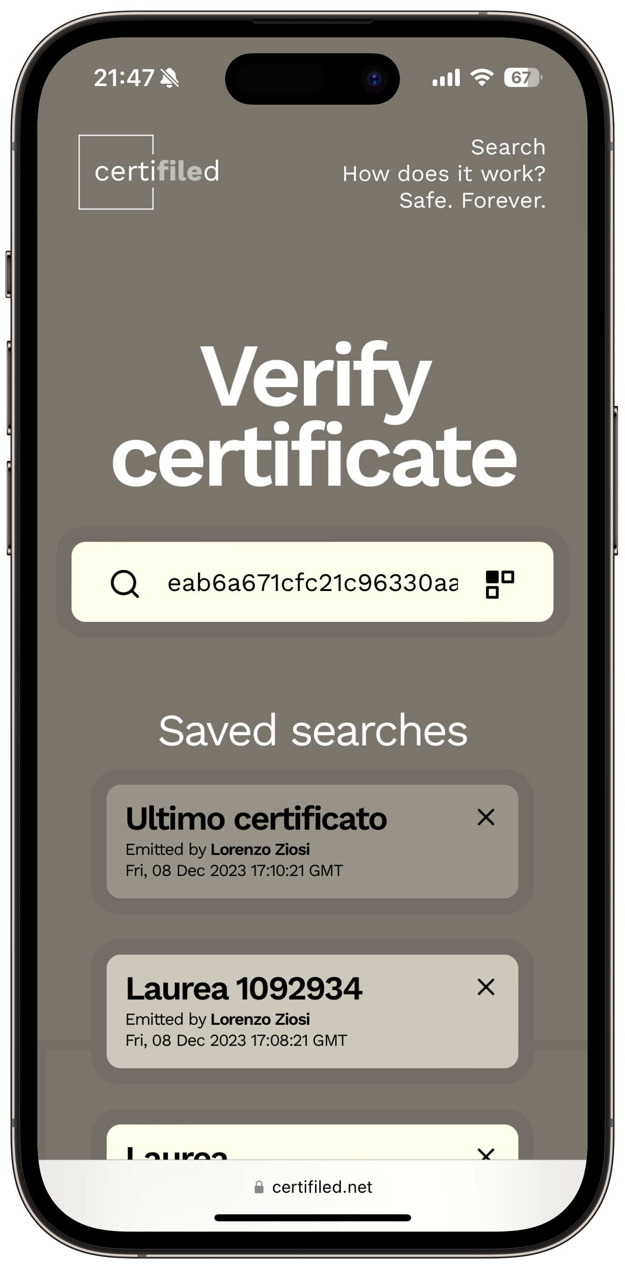

ZDell

Slide 15
ZDell
Blockchain-based platform to handle and safely store digital certificates, with fast and easy to use verification.

Slide 16
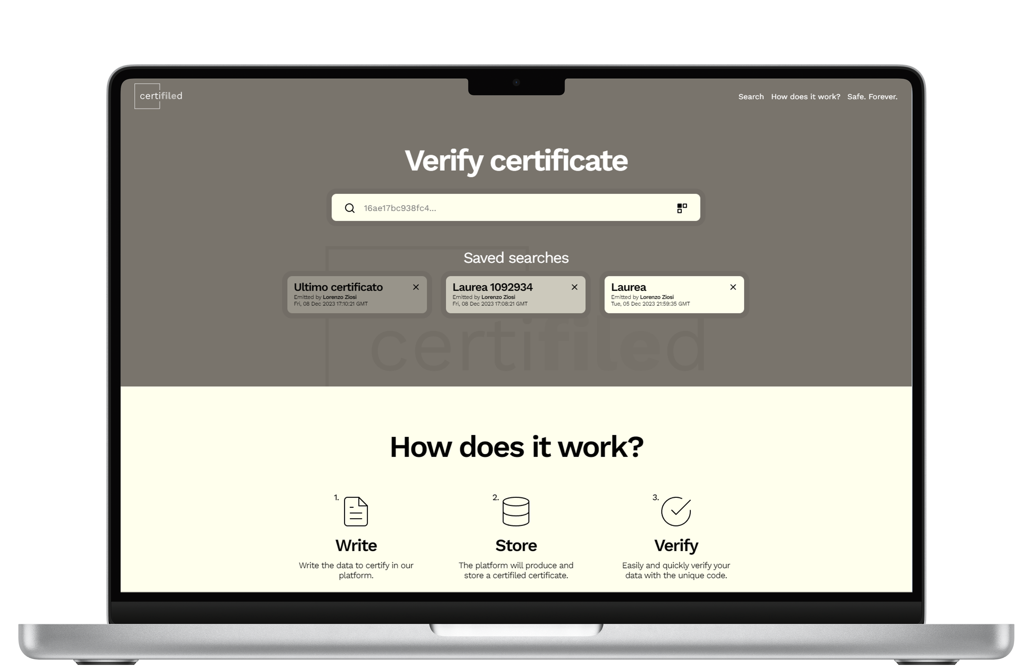
Time
2 minutes
Time required to insert a new certifiled certificate.
Physical archives
100% digital
Falsification
Tamper-proof

Slide 17
Time
2 minutes
Physical archives
100% digital
No paper. All digital.
Falsification
Tamper-proof

Slide 18
Time
2 minutes
Physical archives
100% digital
Falsification
Tamper-proof
Blockchains are safe, decentralized and immutable by nature.

Slide 19



How does it work?
1.
2.
3.
Write
Store
Verify
Write the data to certify in our platform.
The platform will produce and store a certifiled certificate.
Easily and quickly verify your data with the unique code.
Three steps, infinite gain.

Slide 20

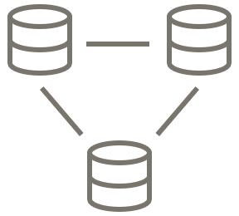

Safe.
Forever.
Blockchain based
IPFS storage
No SPOF
Hashes of the data are permantly stored in blockchain.
The data itself is stored in the Inter Planetary File System.
No single point of failure. Your data will be available even in the worst-case scenario.

Slide 21
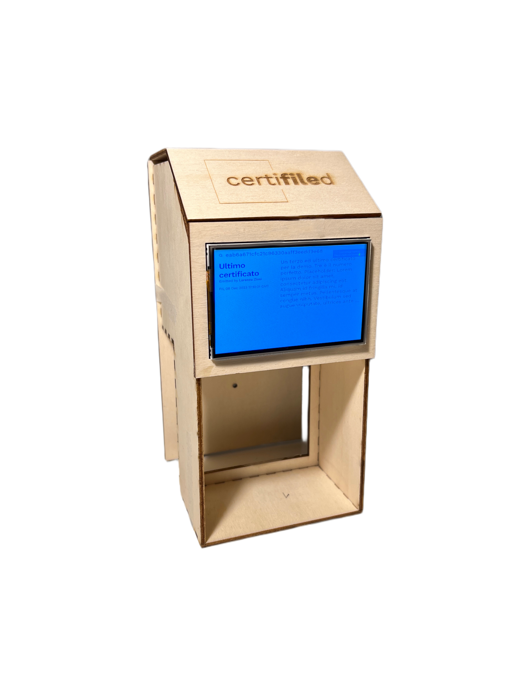
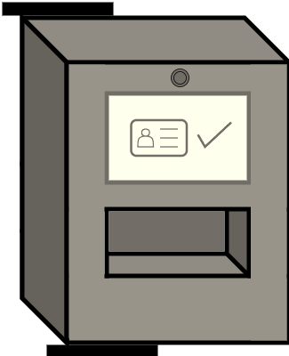



Customizable device
Suitable for everything.
QR reader
Face recognition
NFC
And much more...

Slide 22
Certification Management System Market
+43.5%
$40.2B
+12%
Growth from 2020 to 2023
Expected market size in 2030
Expected growth by 2030 compared to 2023
Source: Polaris Market Research

Slide 23
Future developments
Q1-2 2024
Q4 2024
Strategic partners agreements
User growth
Q1 2024
Q3 2024
2025
Insertion function public release
Improved physical device
certifiled blockchain

Slide 24
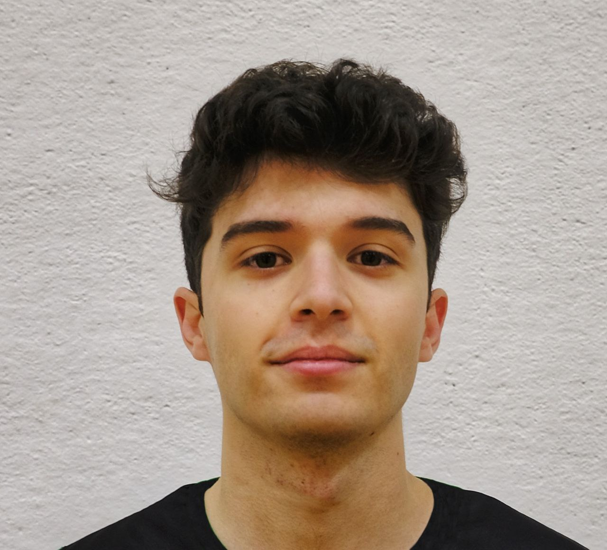
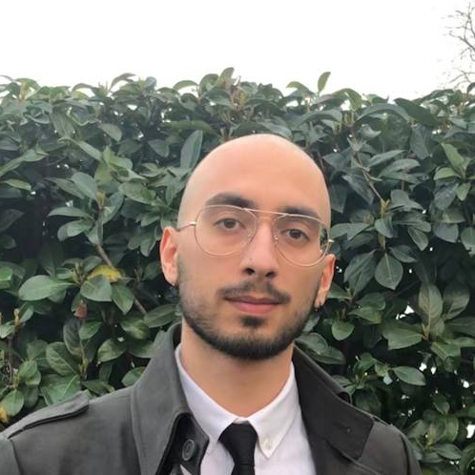
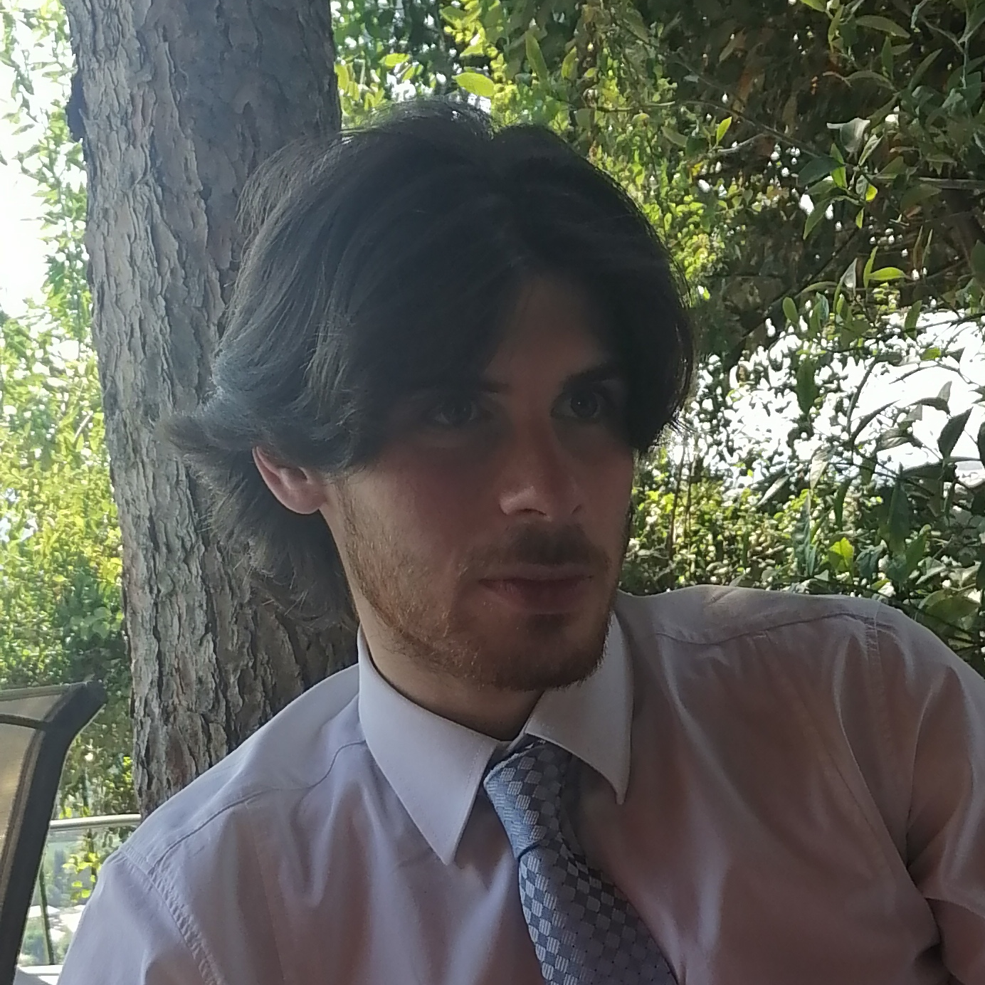
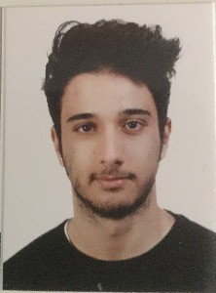
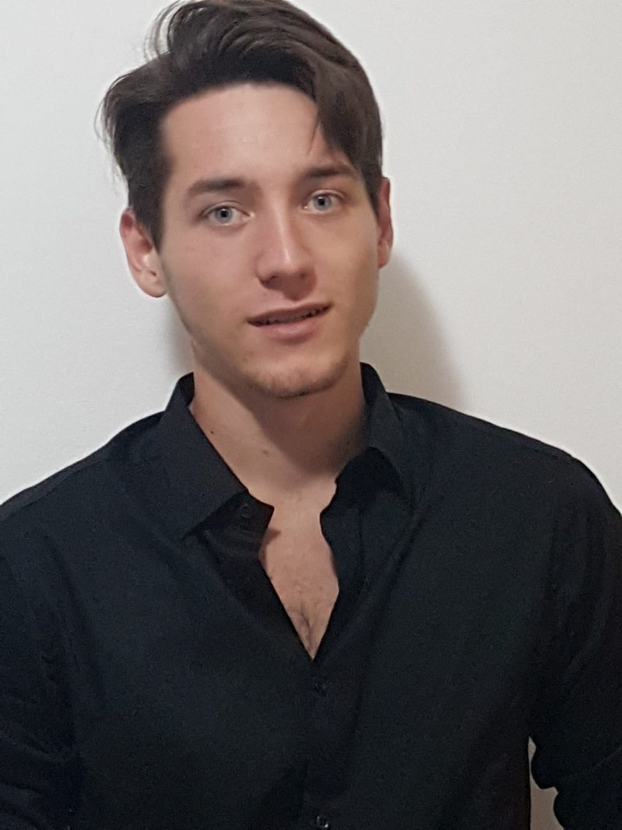
ZDell team
Lorenzo Calarota
Luca Dominici
Enrico Zacchiroli
Lorenzo Ziosi
Luca Sambuchi

Slide 25




Thank you
Try yourself on certifiled.net
Certificate IDs QR codes to scan within the site

Slide 26




Try it yourself
Certificates QRs to scan within the website
.net
Thank
You

Slide 27
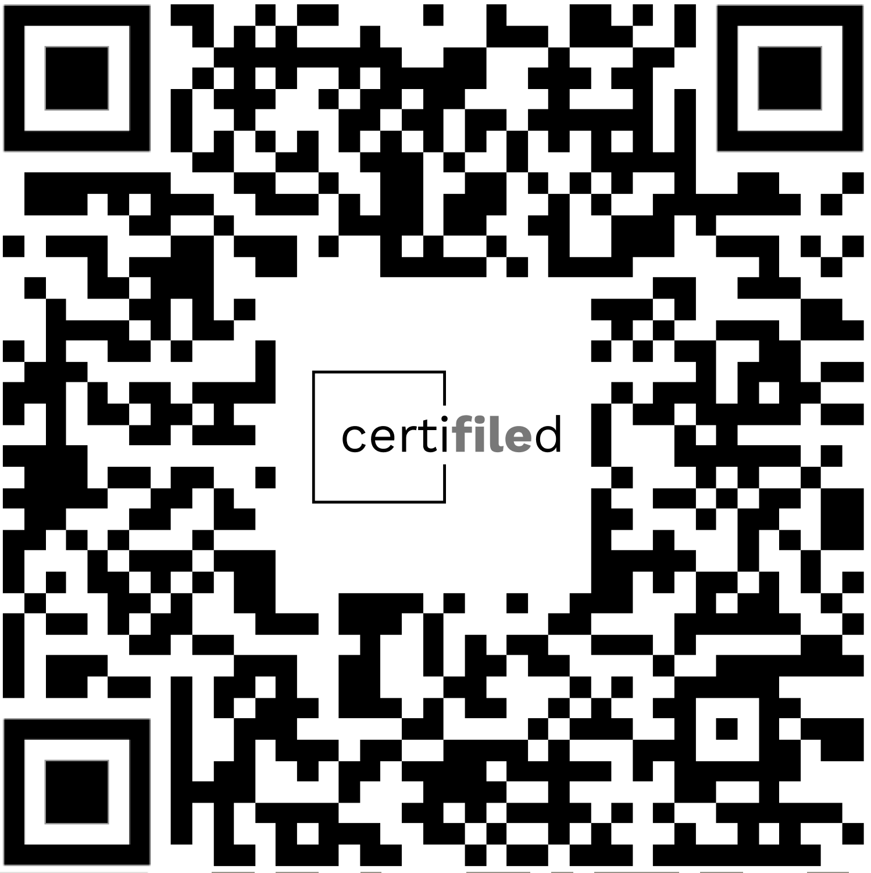
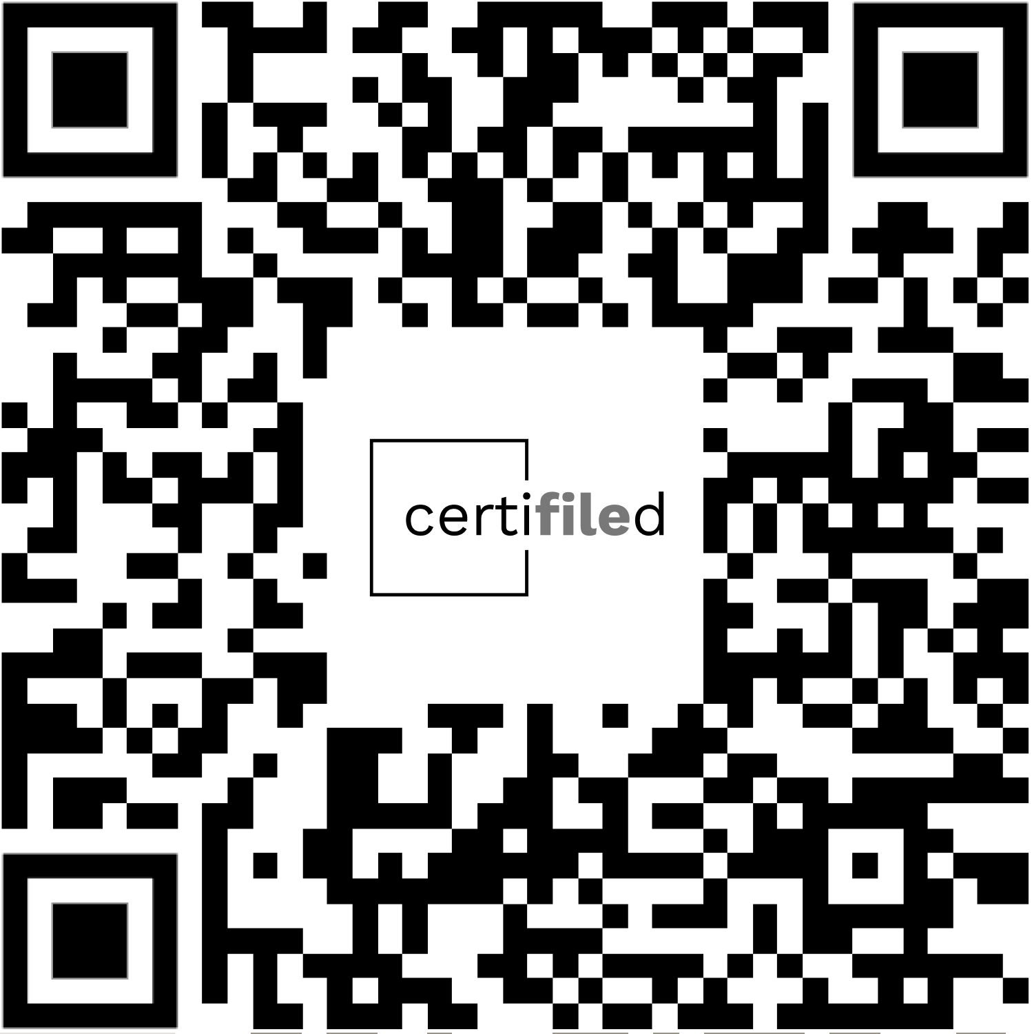

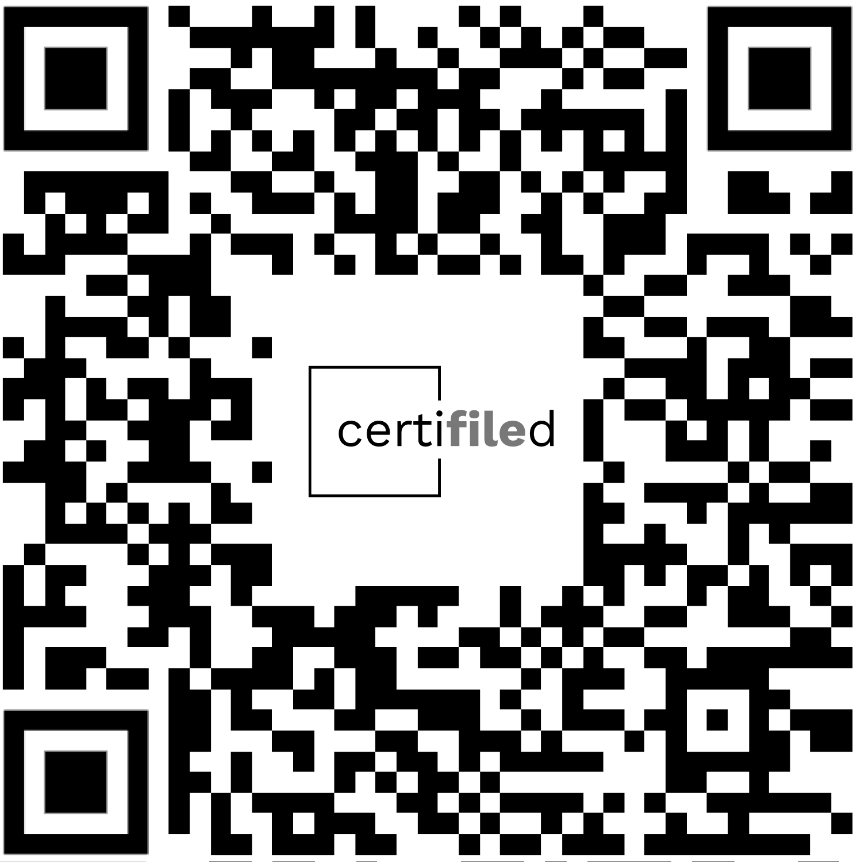
Go to certifiled.net
Thank
You

Slide 28
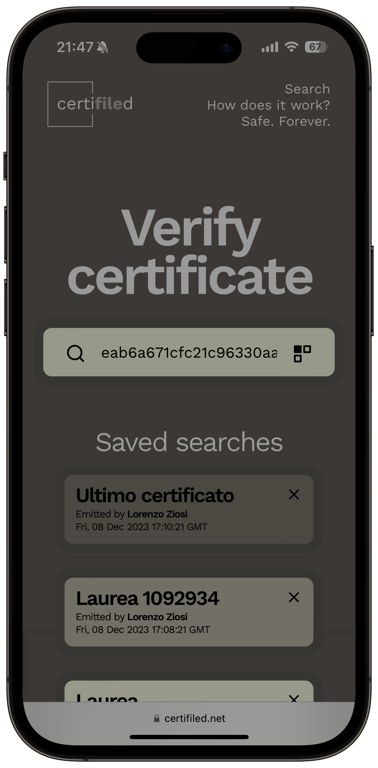
Go to certifiled.net
Thank
You

